Slide 1
BASIC INTERNET PROTOCOLS: ftp, telnet
Mirela Walczak

Slide 2
Why do we speak about protocols on a DISTRIBUTED DATA PROCESSING subject?
CONTENT:
1. Introduction
2. Definitions of protocols
3. Telnet
4. File transfer protocol
5. Differences between FTP and HTTP
Protocol - Is a convention or standard that controls or enables the connection , communication and data transfer between two computing end points

Slide 3
Definitions of protocols
CONTENT:
1. Introduction
2. Definitions of protocols
3. Telnet
4. File transfer protocol
5. Differences between FTP and TELNET
FTP- Is a network protocol used to transfer data from one computer to another through a network such as the Internet (is commonly used for copying files to and from other computers)
TELNET- Is a network protocol which is used for communication between computers

Slide 4
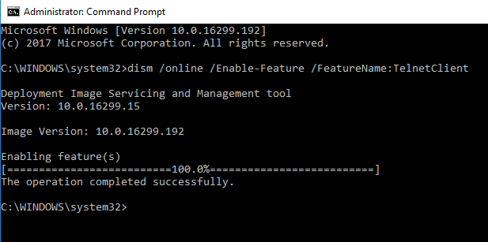
Enable Telnet in Windows 10
Run the following in an admin command prompt: dism /online /Enable-Feature /FeatureName:TelnetClient

Slide 5
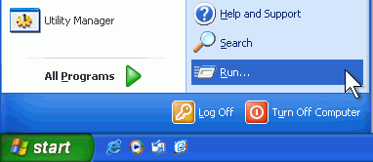
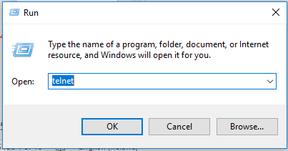
TELNET
CONTENT:
1. Introduction
2. Definitions of protocols
3. Telnet
4. File transfer protocol
5. Differences between FTP and TELNET

Slide 6
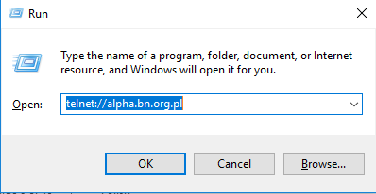

National Library
telnet://alpha.bn.org.pl
CONTENT:
1. Introduction
2. Definitions of protocols
3. Telnet
4. File transfer protocol
5. Differences between FTP and TELNET

Slide 7
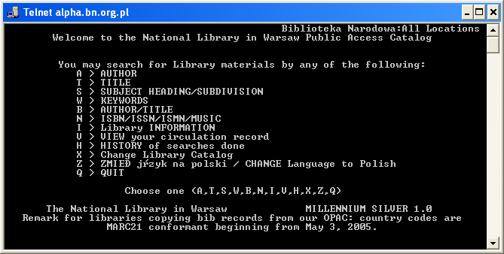
Welcome in library catalogue
CONTENT:
1. Introduction
2. Definitions of protocols
3. Telnet
4. File transfer protocol
5. Differences between FTP and TELNET
Z – Change Language to English

Slide 8
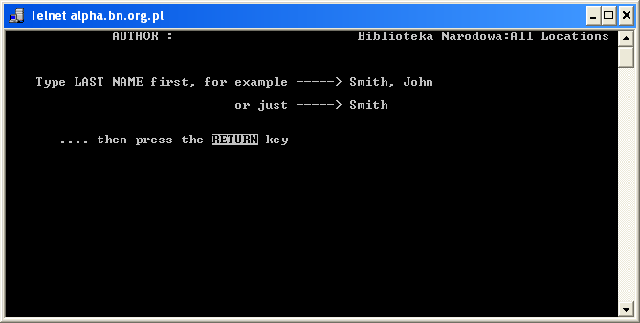
A - author
CONTENT:
1. Introduction
2. Definitions of protocols
3. Telnet
4. File transfer protocol
5. Differences between FTP and TELNET

Slide 9
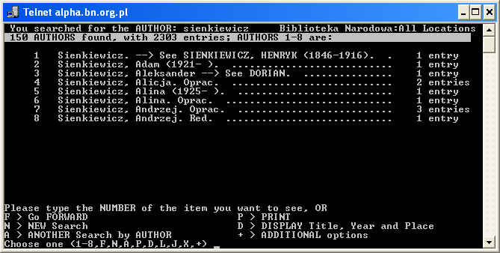
Find - Sienkiewicz
CONTENT:
1. Introduction
2. Definitions of protocols
3. Telnet
4. File transfer protocol
5. Differences between FTP and TELNET

Slide 10
Telnet commands:
CONTENT:
1. Introduction
2. Definitions of protocols
3. Telnet
4. File transfer protocol
5. Differences between FTP and TELNET
Open-Use „open hostname” port number to establish a Telnet connection to a host
Close-Use the close command to close an existing Telnet connection
Display-Use the display command to view the current settings for the Telnet client
Quit-Use the quit command to exit from Telnet.
Status-Use the status command to determine whether the Telnet client is connected
?/help-Prints Help information

Slide 11
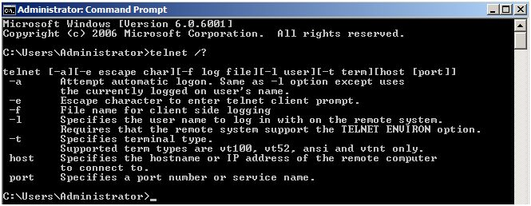
Use help/?
CONTENT:
1. Introduction
2. Definitions of protocols
3. Telnet
4. File transfer protocol
5. Differences between FTP and TELNET

Slide 12
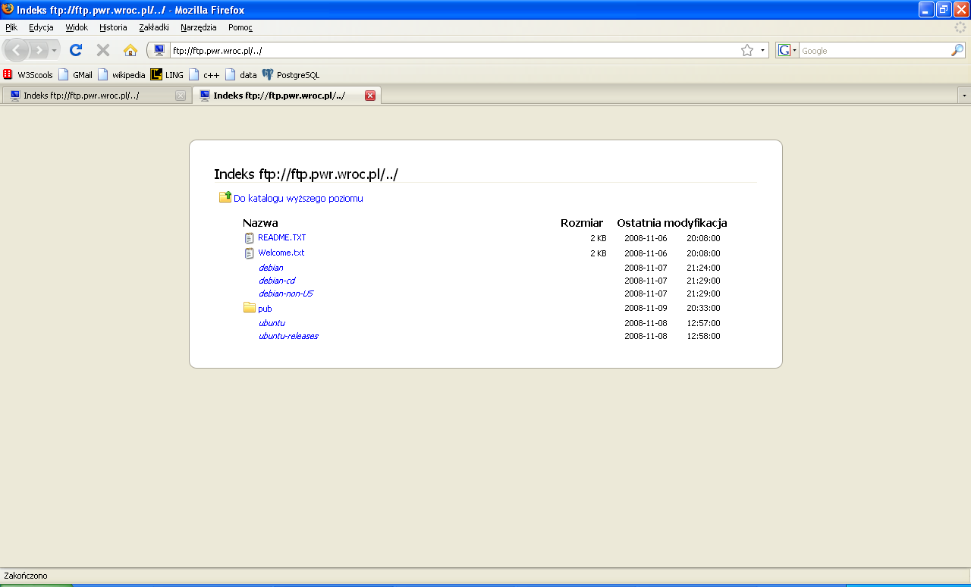
File Transfer Protocol
CONTENT:
1. Introduction
2. Definitions of protocols
3. Telnet
4. File transfer protocol
5. Differences between FTP and TELNET

Slide 13
Examples of other ftp archives:
CONTENT:
1. Introduction
2. Definitions of protocols
3. Telnet
4. File transfer protocol
5. Differences between FTP and TELNET
ftp.cyf-kr.edu.pl
ftp.uci.agh.edu.pl
ftp://ftp.sas.com/pub/neural/FAQ.txt.zip
ftp://ftp.cordis.europa.eu/pub/fp7/docs/financialguide_en.pdf

Slide 14
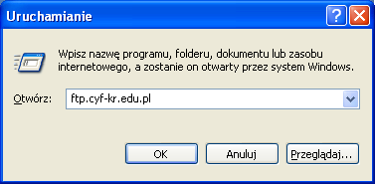
ftp.cyf-kr.edu.pl
CONTENT:
1. Introduction
2. Definitions of protocols
3. Telnet
4. File transfer protocol
5. Differences between FTP and TELNET

Slide 15
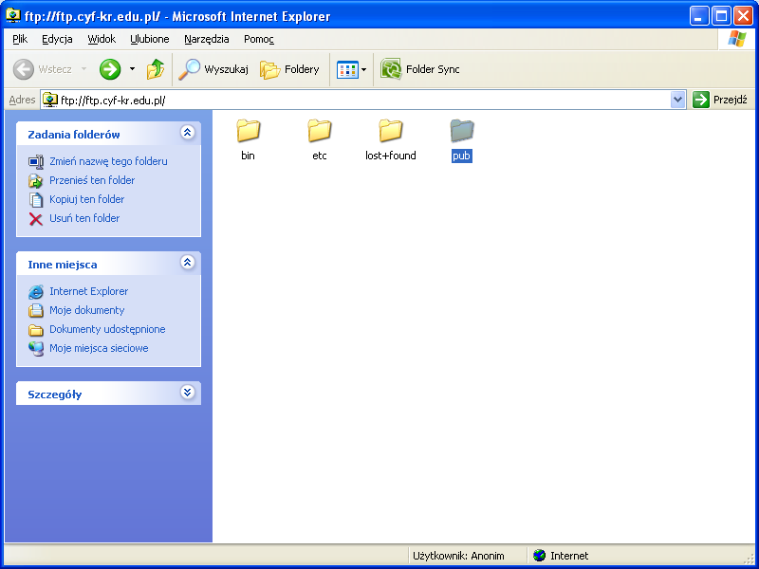
CONTENT:
1. Introduction
2. Definitions of protocols
3. Telnet
4. File transfer protocol
5. Differences between FTP and TELNET

Slide 16
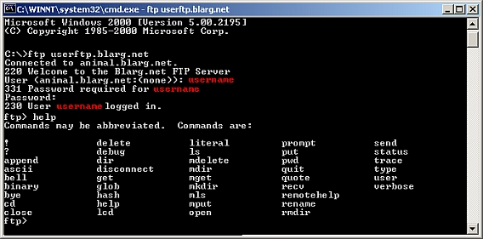
Ftp help - ?
CONTENT:
1. Introduction
2. Definitions of protocols
3. Telnet
4. File transfer protocol
5. Differences between FTP and TELNET

Slide 17
Ftp commands
CONTENT:
1. Introduction
2. Definitions of protocols
3. Telnet
4. File transfer protocol
5. Differences between FTP and TELNET
ASCII-to set the mode of file transfer to ASCII
Binary-to set the mode of file transfer to binary
Bey-to exit the FTP environment (same as quit)
Delete-to delete (remove) a file in the current remote directory
Get-to copy one file from the remote machine to the local machine
Open-to open a connection with another computer
Rmdir-to remove (delete) a directory in the current remote directory

Slide 18
Differences between FTP and TELNET
CONTENT:
1. Introduction
2. Definitions of protocols
3. Telnet
4. File transfer protocol
5. Differences between FTP and TELNET
FTP is a two-way system - it can be used to copy or move files from a server to a client computer as well as upload or transfer files from a client to a server
TELNET is two –way system (with authorization ) it can be used to copy or moves files from other computer
FTP systems generally encode and transmit their data in binary sets which allow for faster data transfer
TELNET while connection client-server communication is non-encoded

Slide 19
Sources:
telnet://alpha.bn.org.pl
http://technet.microsoft.com/en-us/library/c.aspx
http://www.cs.colostate.edu/helpdocs/ftp.html
http://pl.wikipedia.org/wiki/MIME
ftp.cyf-kr.edu.pl

